Slide 1


Manasi H. Patil

Slide 2

Content
Introduction
Mission Statement
ER Diagram
Data Volume
Normalization
Users with High Interaction Frequency
Health Data by Age Group
Most Popular Meal Plan
Correlation between Age & Wellness activity participation
Health Data trends over time
Summary
Challenges Experienced
Lessons Learned

Slide 3
WellnessWave is a health application integrating technology with personal wellness.
Tailored for individuals seeking a personalized approach to health management.
Brings together various health and wellness dimensions in a user-friendly platform.
Utilizes advanced data analysis to provide targeted health insights.
Designed to be a comprehensive solution for everyday health and fitness needs.
Introduction

Slide 4

WellnessWave is committed to revolutionizing personal health management through a sophisticated database-driven approach. Our mission is to leverage advanced database technologies to store, analyze, and interpret health data, providing personalized wellness insights and recommendations. We aim to offer users a seamless and intuitive experience in managing their health records, fitness plans, and nutritional guidelines, all within a secure and efficient data framework. Our goal is to harness the power of data to empower individuals to make informed decisions about their health and well-being.
Mission Statement

Slide 5
User: Represents individuals using the app.
Health Data: Stores health-related information of users.
Wellness Advice: Contains advice or tips related to health and wellness.
Exercise Routine: Details about exercise plans.
Meal Plan: Information on nutritional plans.
Health Buddy: Connects users with companions for mutual health support.
Professional Advisor: Information about health professionals.
ER Diagram
(Entities)

Slide 6
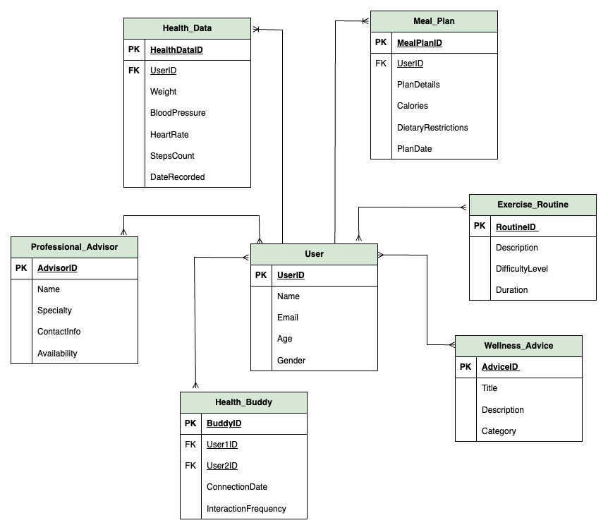
ER Diagram

Slide 7

Data Volume
User_T Table (30)
Primary Data: User profiles and details.
Health_Data Table (30)
Key Data: Individual health metrics and records.
Wellness_Advice Table (20)
Content: Wellness tips and information.
Exercise_Routine Table (20)
Focus: Details of various exercise routines.
Meal_Plan Table (25)
Specialty: Nutritional plans and dietary information.
Health_Buddy Table (25)
Purpose: Connections for mutual health support.
Professional_Advisor Table (10)
Expertise: Information about health professionals.

Slide 8
Normalization
2NF Confirmation: All tables are confirmed to have single-column primary keys, establishing 2NF.
Transition to 3NF: Initiated removal of transitive dependencies to ensure no non-key attribute depends on another non-key attribute.
Strategy: Created new tables to eliminate transitive dependencies, enhancing data integrity and reducing redundancy.

Slide 9
User Contact Separation: Created User_Contact table to store emails. Populated from User_T table and removed Email column.
Meal Plan Refinement: Established Meal_Plan_Details table for plan descriptions. Extracted details from Meal_Plan and refined the original structure.
Integrity Maintenance: Ensured foreign keys maintain referential integrity post-normalization.
Executing Normalization Queries

Slide 10
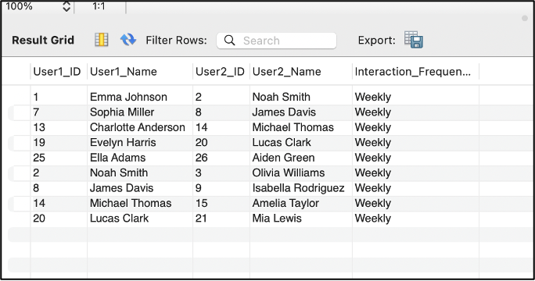
Users with High Interaction Frequency
We identified users who are highly active in the Health Buddy program, potentially indicating a strong commitment to their health and wellness journey.
INNER JOINs, between three tables: Health_Buddy User_T User_T

Slide 11
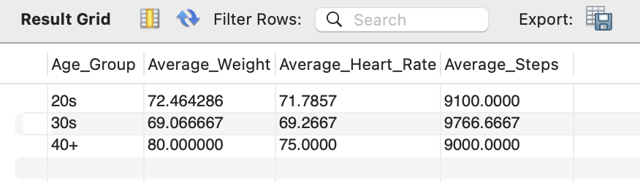
Health Data by Age Group
We designed a query to give a summarized view of health data categorized by different age groups. It is particularly useful for understanding health trends across different age demographics.
Categorized users into age groups ('20s', '30s', or '40+')
Calculated the average weight, heart rate, and steps count for each age group

Slide 12
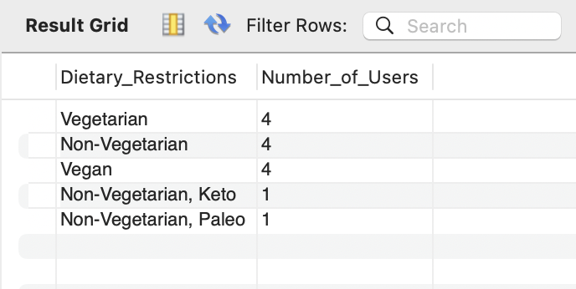
Most Popular Meal Plan
We found the most popular types of meal plans among users based on their dietary restrictions. This could help in tailoring more focused nutritional advice or meal plans in future.
Counted the number of users for each unique dietary restriction.
Sorted the results in descending order, showing the most common dietary restrictions first.

Slide 13
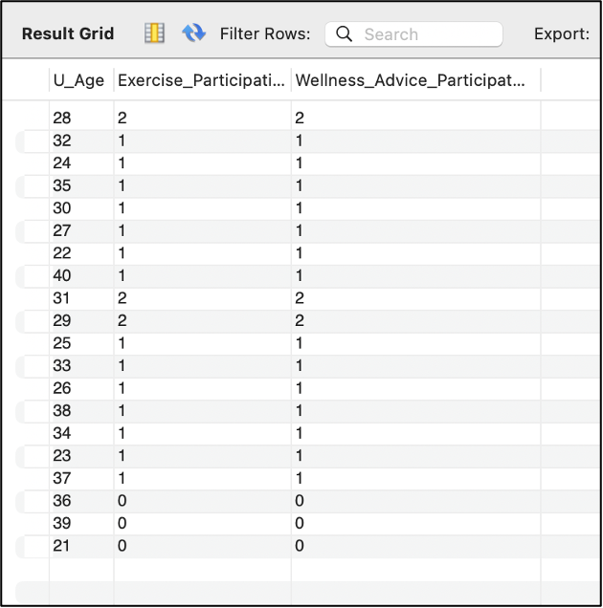
Correlation Between Age and Wellness Activity Participation
We investigated the relationship between age and participation in various wellness activities, such as exercise routines and wellness advice categories. Understanding this correlation can help tailor wellness programs more effectively to different age groups.
Query counts how many exercise routines and wellness advice records are associated with users of each age in the User_T table.
Used left joins to ensure all users are included, even if they don't have related records in the joined tables, and groups the results by age.

Slide 14
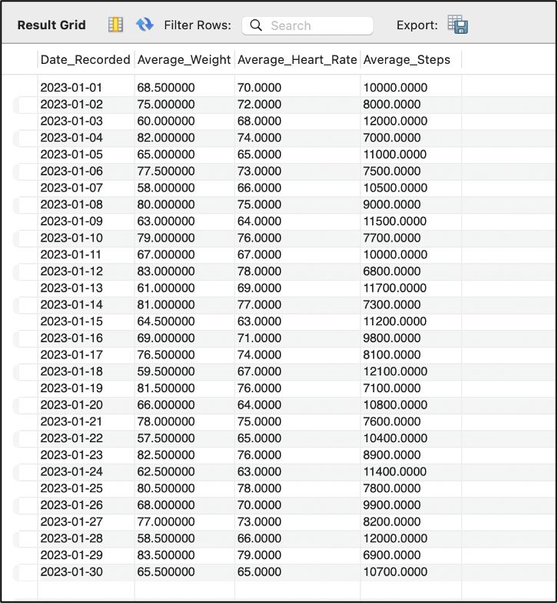
Health Data Trends Over Time
We focused on observing the trends in health data (like weight, blood pressure, and heart rate) over time.
Calculated the average weight, heart rate, and steps count for each date on which health data was recorded.
Grouped and ordered the results by the date the data was recorded.

Slide 15
Comprehensive Database Design: Developed a robust database to manage and analyze health and wellness data, ensuring data integrity and normalization.
Advanced Data Analysis: Implemented complex SQL queries for deep insights into user health trends, interaction frequencies, and dietary preferences.
User-Centric Interface: Focused on a user-friendly interface that provides personalized health insights, enhancing user engagement and experience.
Data Security Emphasis: Prioritized the security and privacy of sensitive health information, aligning with industry standards and regulations.
Valuable Project Insights: Gained key learnings in managing database scalability, user data relationships, and adapting to evolving project requirements.
Summary

Slide 16
Complex Data Relationships: Navigating and implementing complex relationships between various entities such as users, health data, and wellness advice to ensure seamless data integrity and accessibility.
Data Privacy Concerns: Addressing the critical need for securing sensitive health information while adhering to data protection regulations and ensuring user confidentiality.
User Experience Optimization: Striking a balance between a comprehensive feature set and maintaining an intuitive and user-friendly interface.
Scalability and Performance: Ensuring the database could handle an expanding user base and increasing data volume without performance degradation.
Integrating Diverse Data Types: Managing a variety of data inputs, from numerical health metrics to textual meal plans, requiring flexible database schema design.
Adapting to New Requirements: Responding to evolving project requirements and feedback, necessitating iterative redesign and updates to the database structure.
Challenges Experienced

Slide 17
Data Normalization is Crucial: Mastered the importance of efficient database structure to maintain data integrity and reduce redundancy.
User Experience is Key: Learned to balance complex database functionalities with a user-friendly interface, emphasizing usability.
Security and Privacy are Paramount: Gained valuable insights into the necessity of robust data protection measures in handling sensitive health information.
Flexibility in Design: Discovered the importance of an adaptable database design to accommodate evolving requirements and diverse data types.
Effective Communication and Collaboration: Realized the significance of teamwork and clear communication among stakeholders for project success.
Lessons Learned

Slide 18
Thank You!

